Slide 1


<Name>
<Date>

Slide 2

Outline
Executive Summary
Introduction
Methodology
Results
Conclusion
Appendix

Slide 3
Executive Summary
Summary of methodologies
Perform Data collection
Perform data wrangling
Perform exploratory data analysis (EDA) using visualization and SQL
Perform interactive visual analytics using Folium and Plotly Dash
Perform predictive analysis using classification models
Summary of all results
Flight number increase, success rate increases as well.
ES-L1, GEO, HEO, SSO has very high success rate; GTO has very low success rate
VLEO has data for very high flight number.
For LEO, ISS, PO, GTO, the success rate is higher when flightnumber is higher.
Sucess rate since 2013 kept increasing till 2020
LC-39A has the highest success count, Success Rate for LC-39A is 76.9%
Booster version FT seems to have the highest success rate
All 4 models have the same performance for the test accuracy
For confusion matrix:
When true label is landed, predicted label is all correct as landed
When true label is not landed, predicted label is 50% correct

Slide 4
Introduction
Project background and context
In this capstone, we will predict if the Falcon 9 first stage will land successfully.
SpaceX advertises Falcon 9 rocket launches on its website with a cost of 62 million dollars; other providers cost upward of 165 million dollars each, much of the savings is because SpaceX can reuse the first stage.
Therefore if we can determine if the first stage will land, we can determine the cost of a launch. This information can be used if an alternate company wants to bid against SpaceX for a rocket launch.
Problems you want to find answers
predict if the Falcon 9 first stage will land successfully

Slide 5

Section 1

Slide 6
Methodology
Executive Summary
Data collection methodology:
Data was collected either from an API or using Web Scraping method.
Perform data wrangling
Determine Training Labels by converting Landing Outcomes into 1 (success) and 0 (failure)
Perform exploratory data analysis (EDA) using visualization and SQL
Perform interactive visual analytics using Folium and Plotly Dash
Perform predictive analysis using classification models
Create a column for class, Standardize the data, Split into Train/Test set
Find best hyperparameters for Logistic Regression/SVM/Decision Tree/KNN models
Evaluate classification models with accuracy and confusion matrix metrics.

Slide 7
Data Collection
Describe how data sets were collected.
You need to present your data collection process use key phrases and flowcharts
Method 1: API Method Method 2: Web Scraping

Slide 8
Data Collection – SpaceX API
Present your data collection with SpaceX REST calls using key phrases and flowcharts
Add the GitHub URL of the completed SpaceX API calls notebook (must include completed code cell and outcome cell), as an external reference and peer-review purpose
https://github.com/Haihan-W/IBMDSProfessional/blob/main/Course10_Applied%20Data%20Science%20Capstone/Week1.%20Data%20Collection%20and%20Wrangling/1a.%20Data%20Collection%20using%20API%20Method.ipynb
Requests.get() to get data from SpaceX API
convert the json result into a dataframe
Filter df to only include Falcon 9
Replace missing value with mean

Slide 9
Data Collection - Scraping
Present your web scraping process using key phrases and flowcharts
Add the GitHub URL of the completed web scraping notebook, as an external reference and peer-review purpose
https://github.com/Haihan-W/IBMDSProfessional/blob/main/Course10_Applied%20Data%20Science%20Capstone/Week1.%20Data%20Collection%20and%20Wrangling/1b.%20Data%20Collection%20using%20Web%20Scraping%20Method.ipynb
Requests.get() to get data from Wiki HTML page
Create BeautifulSoup Object from HTML response
Extract all column/variable names from the HTML table header
Create a data frame by parsing the launch HTML tables

Slide 10
Data Wrangling
Describe how data were processed
Determine Training Labels by converting Landing Outcomes into 1 (success) and 0 (failure)
You need to present your data wrangling process using key phrases and flowcharts
Add the GitHub URL of your completed data wrangling related notebooks, as an external reference and peer-review purpose
https://github.com/Haihan-W/IBMDSProfessional/blob/main/Course10_Applied%20Data%20Science%20Capstone/Week1.%20Data%20Collection%20and%20Wrangling/2.%20Data%20Wrangling.ipynb
Determine Label column: “Outcomes” (i.e. Y label)
Get unique list of Outcomes
Differentiate bad outcomes (i.e. landing fails) vs good outcomes (i.e. landing success)
Convert bad outcomes to 0 and good outcomes to 1, and add to dataframe as “Class” column

Slide 11
EDA with Data Visualization
Summarize what charts were plotted and why you used those charts
1. PayloadMass vs. FlightNumber and outcomes of the launch. To observe if launch success will have positive or negative relationship with either flight number or pay load mass.
2. Launch Site vs. Flight Number and outcomes of the launch. To observe which site have more success rate and its relationship with flight number
3. Launch Site vs. Payload and outcomes of the launch. To observe which site have more success rate and its relationship with payload mass
4. Average Success Rate of each orbit type
5. Orbit vs. Flight Number and outcomes of the launch. To observe which orbit has more success rate and its relationship with flight number
6. Avg success rate of each year. To observe if overall success rate is increasing.
Add the GitHub URL of your completed EDA with data visualization notebook, as an external reference and peer-review purpose
https://github.com/Haihan-W/IBMDSProfessional/blob/main/Course10_Applied%20Data%20Science%20Capstone/Week2.%20EDA%20(Exploratory%20Data%20Analysis)/Lab%202.%20EDA%20with%20Pandas%20and%20Matplotlib_Seaborn.ipynb

Slide 12
EDA with SQL
Using bullet point format, summarize the SQL queries you performed
Display the names of the unique launch sites in the space mission
Display 5 records where launch sites begin with the string 'CCA'
Display the total payload mass carried by boosters launched by NASA (CRS)
Display average payload mass carried by booster version F9 v1.1
List the date when the first successful landing outcome in ground pad was acheived.
List the names of the boosters which have success in drone ship and have payload mass greater than 4000 but less than 6000
List the total number of successful and failure mission outcomes
List the names of the booster_versions which have carried the maximum payload mass. Use a subquery
List the failed landing_outcomes in drone ship, their booster versions, and launch site names for in year 2015
Rank the count of landing outcomes (such as Failure (drone ship) or Success (ground pad)) between the date 2010-06-04 and 2017-03-20, in descending order
Add the GitHub URL of your completed EDA with SQL notebook, as an external reference and peer-review purpose
https://github.com/Haihan-W/IBMDSProfessional/blob/main/Course10_Applied%20Data%20Science%20Capstone/Week2.%20EDA%20(Exploratory%20Data%20Analysis)/Lab%201.%20EDA%20with%20SQL.ipynb

Slide 13
Build an Interactive Map with Folium
Summarize what map objects such as markers, circles, lines, etc. you created and added to a folium map; Explain why you added those objects
Circle object to indicate NASA Johnson Space Center
Marker object as a text marker to show NASA Johnson Space Center’s name on map
Circle and Marker objects for each launch site
Marker_Cluster object to indicate success vs fail launch outcomes with different marker color
PolyLine object to show the distance between two points on the map
Add the GitHub URL of your completed interactive map with Folium map, as an external reference and peer-review purpose
https://github.com/Haihan-W/IBMDSProfessional/blob/main/Course10_Applied%20Data%20Science%20Capstone/Week3.%20Interactive%20Visual%20Analytics%20and%20Dashboard/Lab1_Interactive%20Visual%20Analytics%20with%20Folium.ipynb

Slide 14
Build a Dashboard with Plotly Dash
Summarize what plots/graphs and interactions you have added to a dashboard; Explain why you added those plots and interactions
Add a dropdown list to enable Launch Site selection
Add a pie chart to show the total successful launches count for all sites
If a specific launch site was selected, show the Success vs. Failed counts for the site
Add a slider to select payload range
Add a scatter chart to show the correlation between payload and launch success, based on selected site and payload range
Add the GitHub URL of your completed Plotly Dash lab, as an external reference and peer-review purpose
https://github.com/Haihan-W/IBMDSProfessional/blob/main/Course10_Applied%20Data%20Science%20Capstone/Week3.%20Interactive%20Visual%20Analytics%20and%20Dashboard/Lab2_spacex_dash_app.py

Slide 15
Predictive Analysis (Classification)
Assign “Class” column from dataframe to Y variable
Summarize how you built, evaluated, improved, and found the best performing classification model
Create a column for class, Standardize the data, Split into Train/Test set
Find best hyperparameters for Logistic Regression/SVM/Decision Tree/KNN models
Evaluate classification models with accuracy and confusion matrix metrics.
You need present your model development process using key phrases and flowchart
See right
Add the GitHub URL of your completed predictive analysis lab, as an external reference and peer-review purpose
https://github.com/Haihan-W/IBMDSProfessional/blob/main/Course10_Applied%20Data%20Science%20Capstone/Week4.%20Predictive%20Analysis%20using%20ML/Machine%20Learning%20Prediction.ipynb
Standarize features X
Train/Test Split
Create Logistic Regression object and using GridSearchSV to find best parameters using training dataset
Get accuracy metrics and confusion matrix using test dataset
Do the same for SVM, Decision Tree, and KNN

Slide 16
Results
Exploratory data analysis results
Interactive analytics demo in screenshots
Predictive analysis results

Slide 17

Section 2

Slide 18
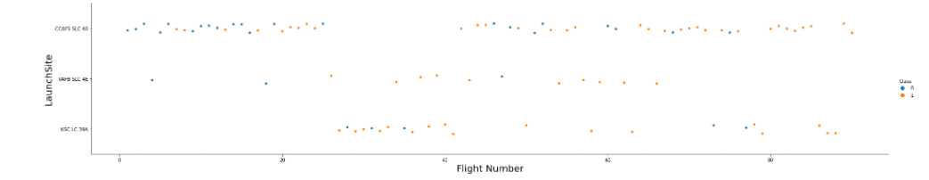
Flight Number vs. Launch Site
Show a scatter plot of Flight Number vs. Launch Site
Show the screenshot of the scatter plot with explanations
Flight number increase, success rate increases as well.
This applies for all three lauch sites

Slide 19
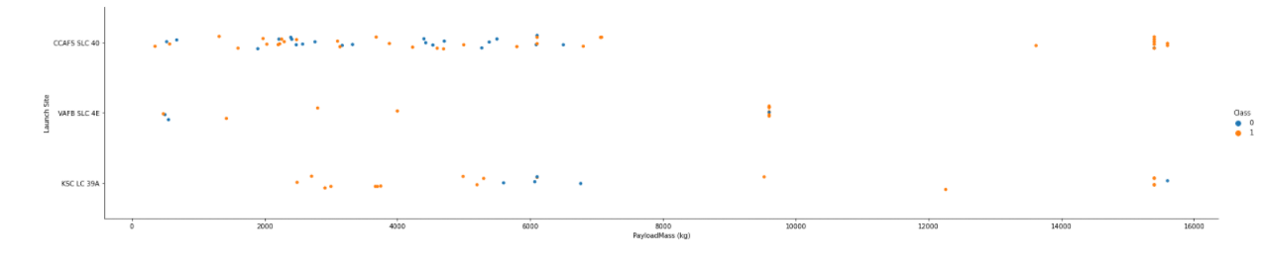
Payload vs. Launch Site
Show a scatter plot of Payload vs. Launch Site
Show the screenshot of the scatter plot with explanations
For these three sites, it is observed that there is no strongly relationship between payload and success rate.

Slide 20
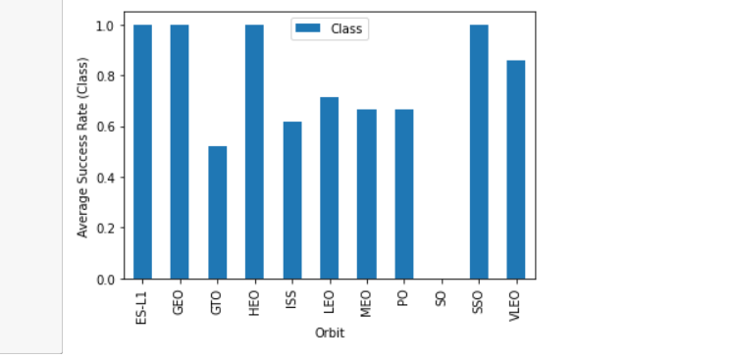
Success Rate vs. Orbit Type
Show a bar chart for the success rate of each orbit type
Show the screenshot of the scatter plot with explanations
ES-L1, GEO, HEO, SSO has very high success rate
GTO has very low success rate
SO does not have success rate data or its success rate is 0.

Slide 21
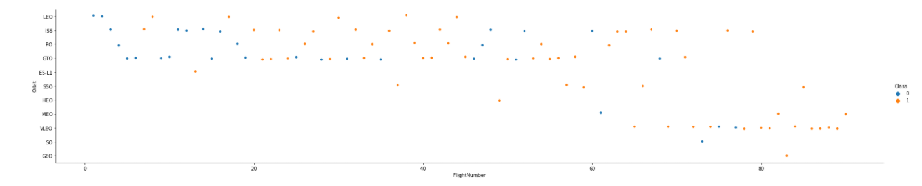
Flight Number vs. Orbit Type
Show a scatter point of Flight number vs. Orbit type
Show the screenshot of the scatter plot with explanations
VLEO has data for very high flight number.
For LEO, ISS, PO, GTO, the success rate is higher when flightnumber is higher.

Slide 22
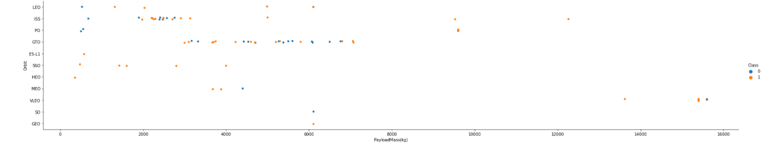
Payload vs. Orbit Type
Show a scatter point of payload vs. orbit type
Show the screenshot of the scatter plot with explanations
VLEO has higher payload mass than other orbits
For LEO, ISS, PO orbit types, payload increases, success rate decreases.

Slide 23
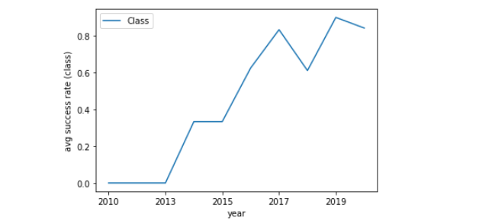
Launch Success Yearly Trend
Show a line chart of yearly average success rate
Show the screenshot of the scatter plot with explanations
Sucess rate since 2013 kept increasing till 2020

Slide 24
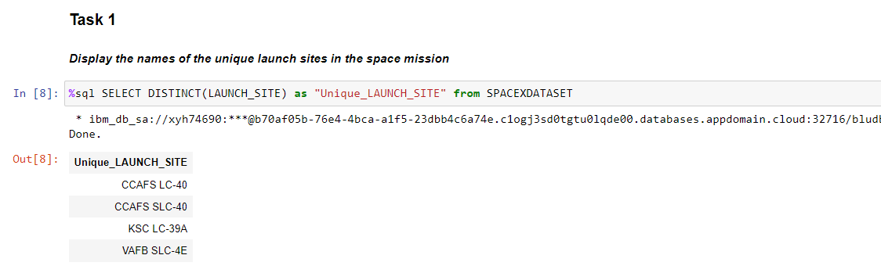
All Launch Site Names
Find the names of the unique launch sites
Present your query result with a short explanation here

Slide 25
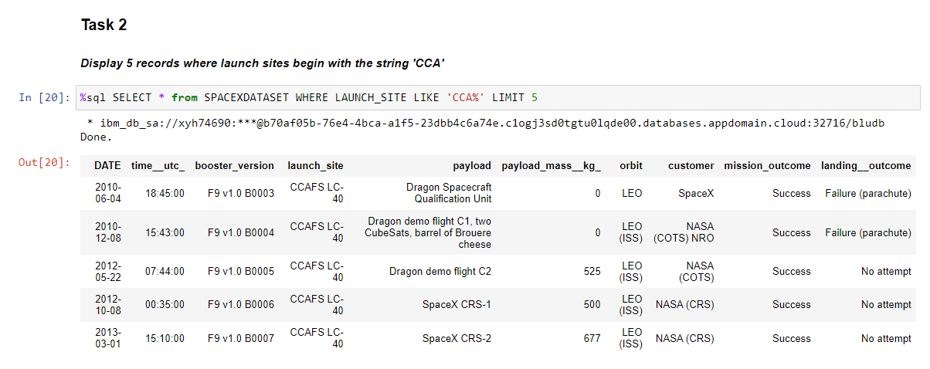
Launch Site Names Begin with 'CCA'
Find 5 records where launch sites begin with `CCA`
Present your query result with a short explanation here

Slide 26
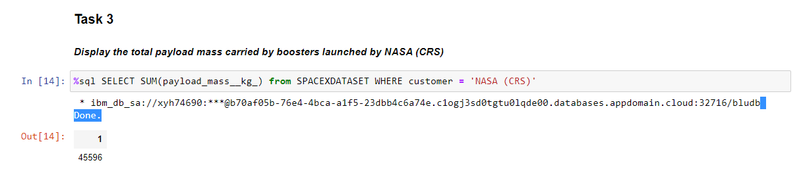
Total Payload Mass
Calculate the total payload carried by boosters from NASA
Present your query result with a short explanation here

Slide 27
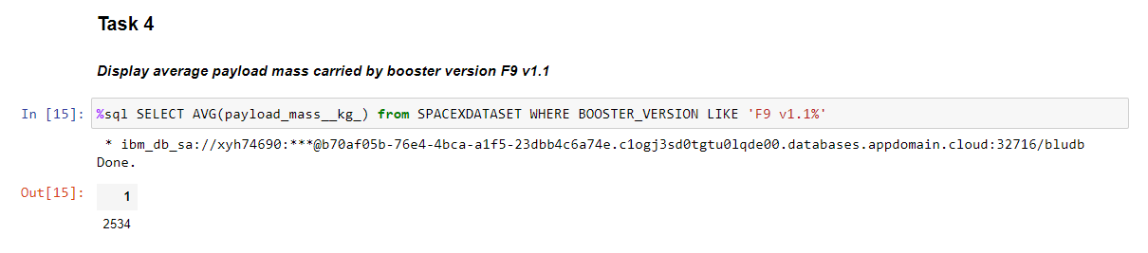
Average Payload Mass by F9 v1.1
Calculate the average payload mass carried by booster version F9 v1.1
Present your query result with a short explanation here

Slide 28
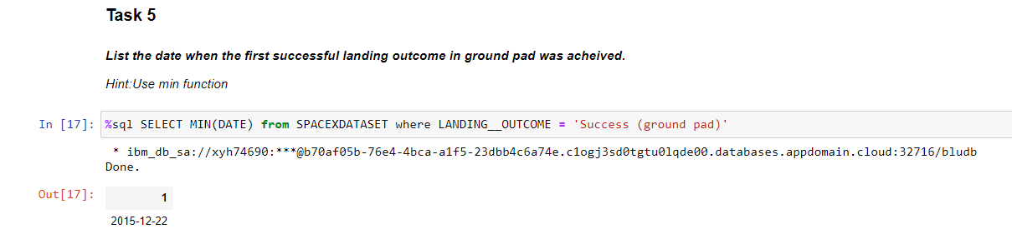
First Successful Ground Landing Date
Find the dates of the first successful landing outcome on ground pad
Present your query result with a short explanation here

Slide 29
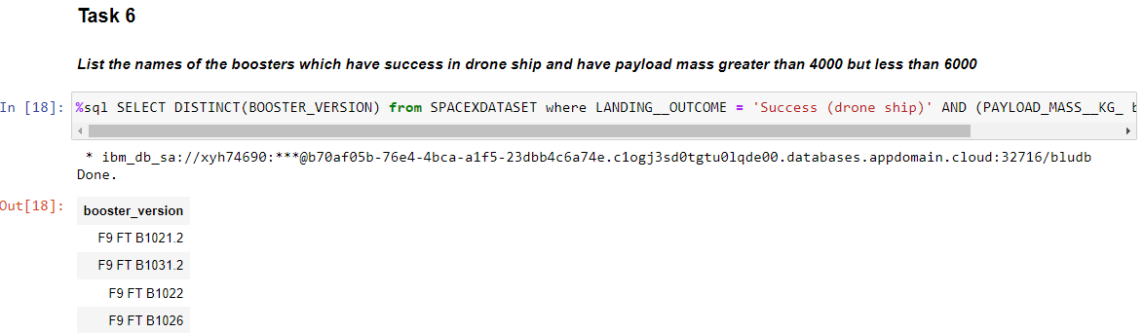
Successful Drone Ship Landing with Payload between 4000 and 6000
List the names of boosters which have successfully landed on drone ship and had payload mass greater than 4000 but less than 6000
Present your query result with a short explanation here

Slide 30
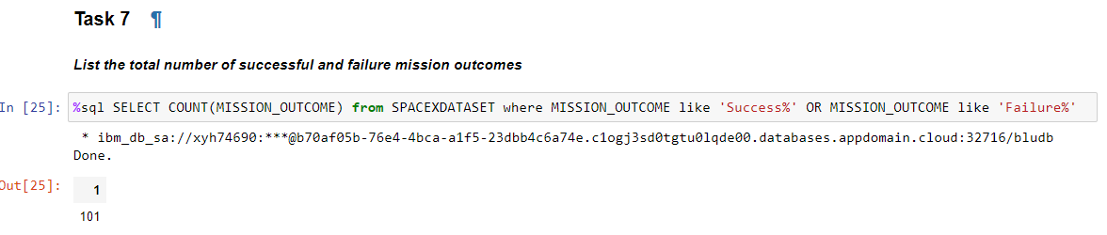
Total Number of Successful and Failure Mission Outcomes
Calculate the total number of successful and failure mission outcomes
Present your query result with a short explanation here

Slide 31
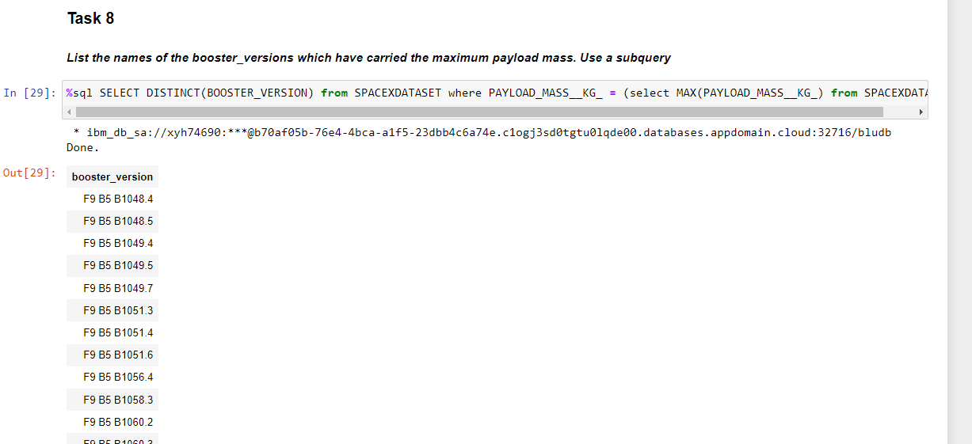
Boosters Carried Maximum Payload
List the names of the booster which have carried the maximum payload mass
Present your query result with a short explanation here

Slide 32
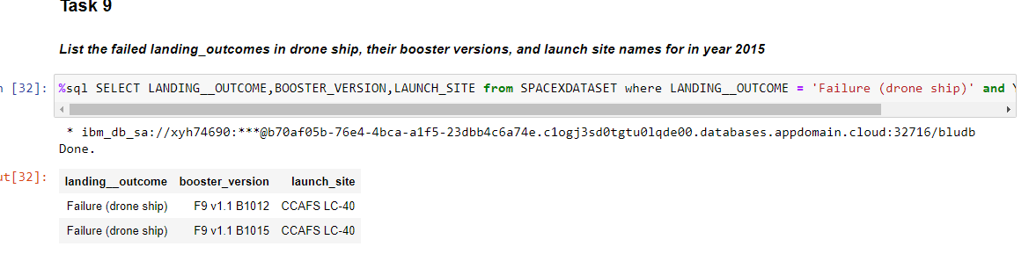
2015 Launch Records
List the failed landing_outcomes in drone ship, their booster versions, and launch site names for in year 2015
Present your query result with a short explanation here

Slide 33
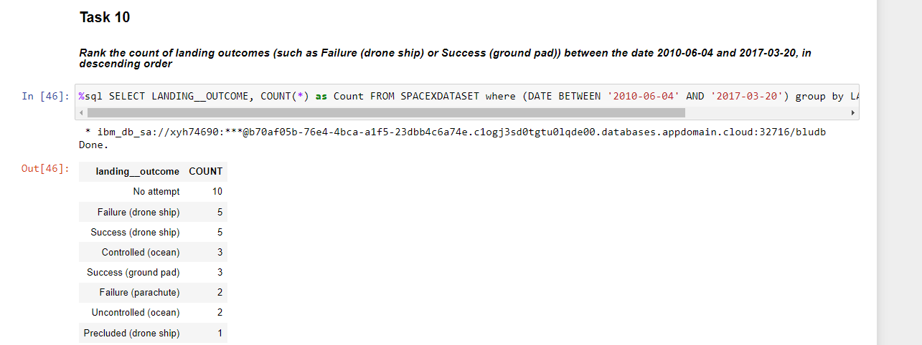
Rank Landing Outcomes Between 2010-06-04 and 2017-03-20
Rank the count of landing outcomes (such as Failure (drone ship) or Success (ground pad)) between the date 2010-06-04 and 2017-03-20, in descending order
Present your query result with a short explanation here

Slide 34

Section 3

Slide 35
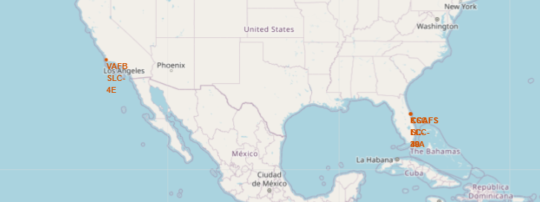
Folium Map - all launch sites’ location markers
Explore the generated folium map and make a proper screenshot to include all launch sites’ location markers on a global map
Explain the important elements and findings on the screenshot
VAFB SLC-4E is on west coast
All other sites are on east coast

Slide 36
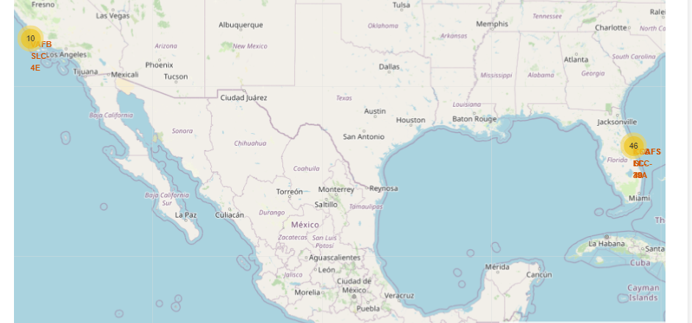
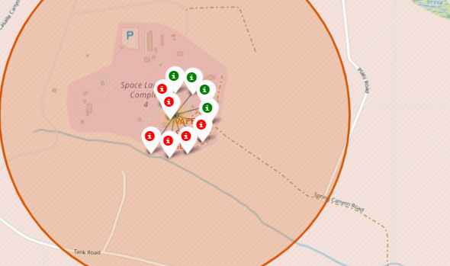
Folium Map - all launch sites’ location markers and color-labeled launch outcomes on the map
Replace <Folium map screenshot 2> title with an appropriate title
Explore the folium map and make a proper screenshot to show the color-labeled launch outcomes on the map
Explain the important elements and findings on the screenshot

Slide 37
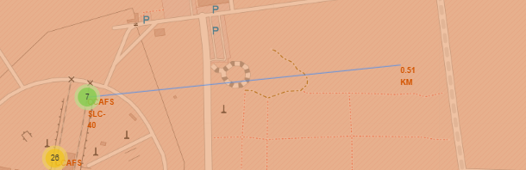
Folium Map with distance indication between SLC-40 Site to Coastline
Replace <Folium map screenshot 3> title with an appropriate title
Explore the generated folium map and show the screenshot of a selected launch site to its proximities such as railway, highway, coastline, with distance calculated and displayed
Explain the important elements and findings on the screenshot
0.51 km between SLC-40 and coastline

Slide 38

Section 4

Slide 39
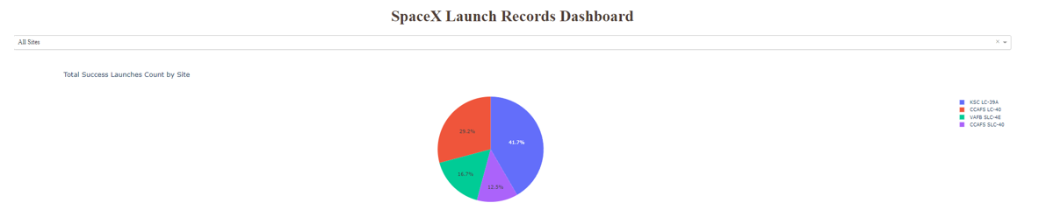
Launch Success Count in a Pie Chart for all Sites
Replace <Dashboard screenshot 1> title with an appropriate title
Show the screenshot of launch success count for all sites, in a piechart
Explain the important elements and findings on the screenshot
LC-39A has the highest success count

Slide 40
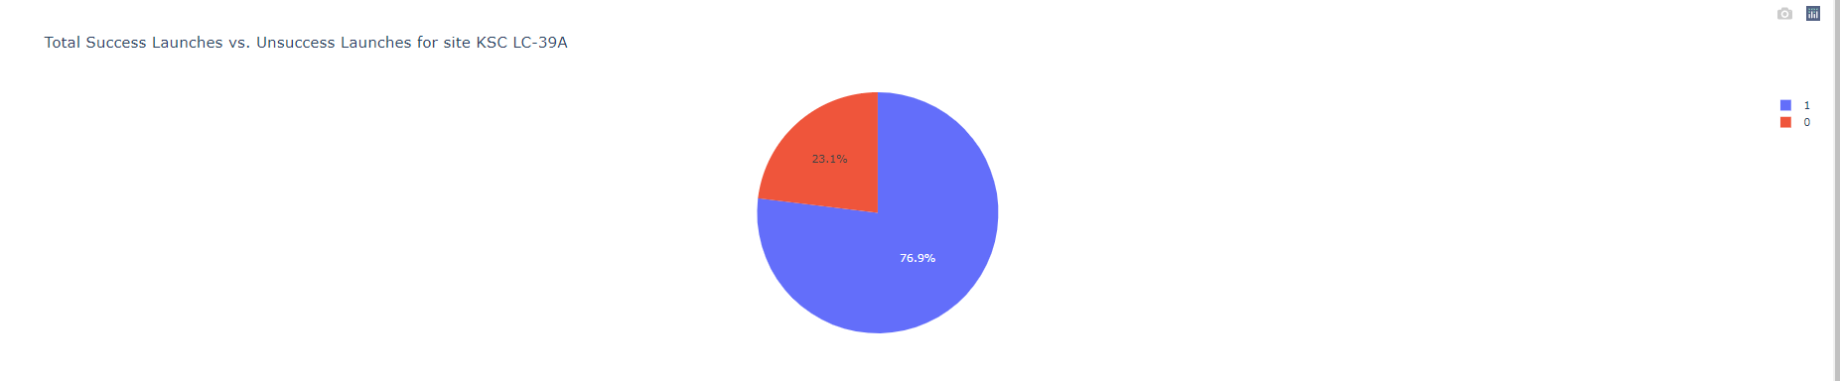
Piechart for the launch site with highest launch success ratio
Replace <Dashboard screenshot 2> title with an appropriate title
Show the screenshot of the piechart for the launch site with highest launch success ratio
Explain the important elements and findings on the screenshot
Success Rate for LC-39A is 76.9%

Slide 41
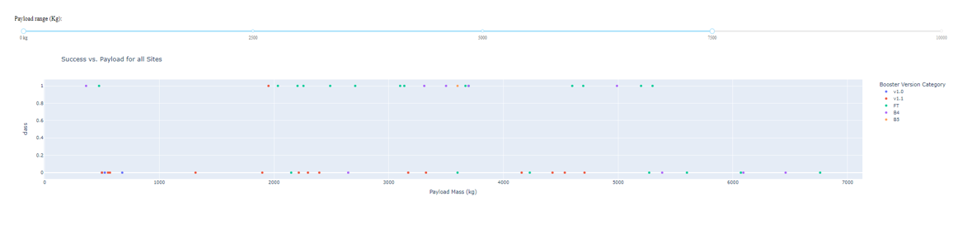
Launch Outcome vs. Payload for all sites
Replace <Dashboard screenshot 3> title with an appropriate title
Show screenshots of Payload vs. Launch Outcome scatter plot for all sites, with different payload selected in the range slider
Explain the important elements and findings on the screenshot, such as which payload range or booster version have the largest success rate, etc.
FT seems to have the highest success rate from the chart

Slide 42

Section 5

Slide 43
Classification Accuracy
Visualize the built model accuracy for all built classification models, in a bar chart
Find which model has the highest classification accuracy
All 4 algorithm have the same performance for the test accuracy

Slide 44
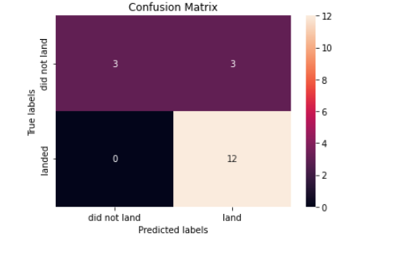
Confusion Matrix
Show the confusion matrix of the best performing model with an explanation
When true label is landed, predicted label is all correct as landed
When true label is not landed, predicted label is 50% correct.

Slide 45
Conclusions
Flight number increase, success rate increases as well.
ES-L1, GEO, HEO, SSO has very high success rate; GTO has very low success rate
VLEO has data for very high flight number.
For LEO, ISS, PO, GTO, the success rate is higher when flightnumber is higher.
Sucess rate since 2013 kept increasing till 2020
LC-39A has the highest success count, Success Rate for LC-39A is 76.9%
Booster version FT seems to have the highest success rate
All 4 models have the same performance for the test accuracy
For confusion matrix:
When true label is landed, predicted label is all correct as landed
When true label is not landed, predicted label is 50% correct

Slide 46
Appendix
Include any relevant assets like Python code snippets, SQL queries, charts, Notebook outputs, or data sets that you may have created during this project

Slide 47


